Slide 1
Distributed transaction using Saga pattern
</
} /> [
/>
Speaker: Trung Tran

Slide 2
</ Table of contents
{01}
{05}
Context & problems
Saga - Orchestrator
{02}
{06}
Saga - The solution
Issues & considerations
{03}
{07}
Techniques in Saga
Practical usage
{04}
{08}
Saga - Choreography
Discussion & QnA

Slide 3
</ Prerequisites
Must have
Basic knowledge in software architecture
Understanding of remote communication between servers/software components
Understanding of concurrency concepts
Nice to have
C#, .NET knowledge
Understanding of async communication
Experience of Docker
/>

Slide 4

</ Resources
Repository URL:
https://github.com/trannamtrung1st/SagaSeminar
Requirements:
.NET SDK 6.0
Docker Desktop
/>

Slide 5
</ Contact
Want to connect?
trannamtrung1st@gmail.com
(+84)76 544 1077 https://www.linkedin.com/in/trung-tran99/
} /> [
/>

Slide 6
01
Context & problems
</>
} /> [

Slide 7
</ 1. Context & problems
Relational database & transactions
Transaction is a single unit of logic or work
ACID: atomic, consistent, isolated, and durable
/>

Slide 8
</ 1. Context & problems
Transaction in a distributed system
Atomicity: a single unit with set of operations that must all occur or none occur
Consistency: data should only move from one state to another expected valid state in all participants
Isolation: ensures that concurrent transactions result in the same outcome when running sequentially
Durability: makes the commit status of transactions persistent and be able to bear with failure related to system or power outage

Slide 9
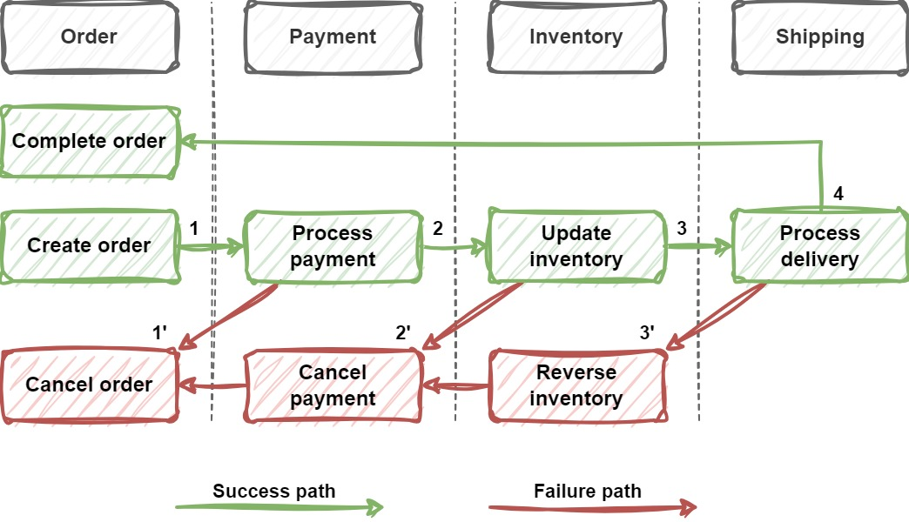
</ 1. Context & problems
Sample order processing system
/>

Slide 10
</ 1. Context & problems
Problems with transaction in a distributed environment
Usage of database-per-microservice, NoSQL databases, message brokers, file storage
-> Two-phase commit (2PC) protocol does not work
/>

Slide 11
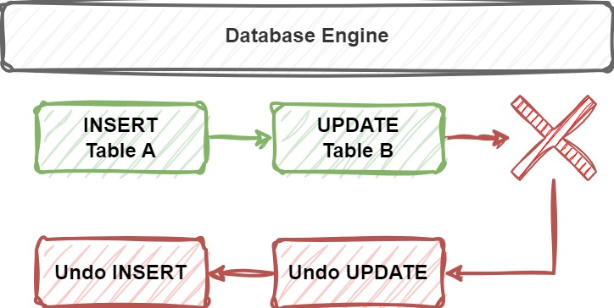
</ 1. Context & problems
Problems with transaction in a distributed environment
Complicated rollback operations
/>

Slide 12
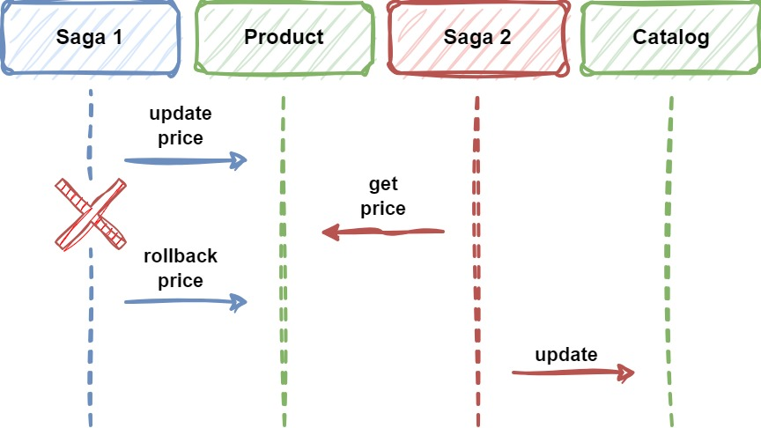
</ 1. Context & problems
Problems with transaction in a distributed environment
Atomicity, consistency and isolation is a challenge
/>

Slide 13
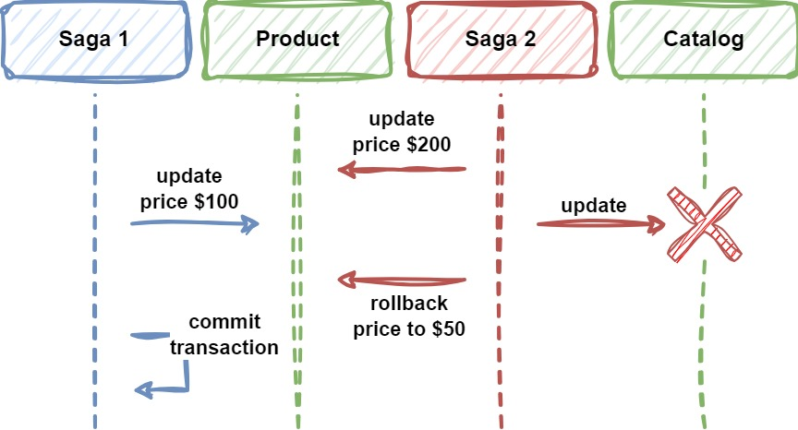
</ 1. Context & problems
Problems with transaction in a distributed environment
Limitations with synchronicity and availability
/>

Slide 14
02
Saga - The solution
</>
} /> [

Slide 15
</ 2. Saga - The solution
What is Saga pattern?
A transaction management strategy involving with multiple local transactions
A local transaction is performed by a saga participant
Each local transaction performs its transaction, then publishes events to trigger the next transaction
If local transaction fails, the saga will execute a series of compensating transactions that reverse/compensate the changes made before
/>

Slide 16
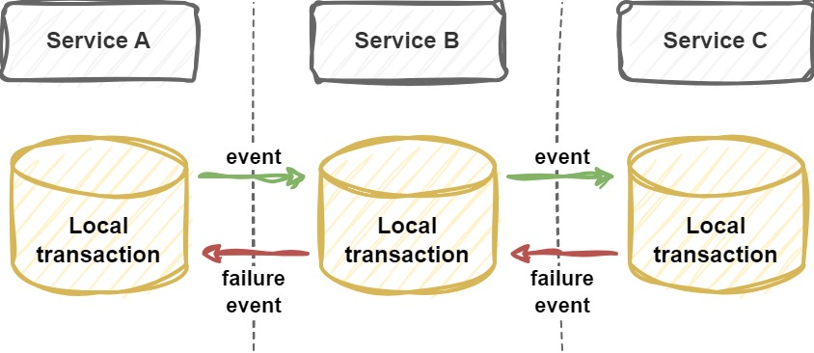
</ 2. Saga - The solution
What is Saga pattern?
/>

Slide 17
</ 2. Saga - The solution
Saga pattern - Concepts
Participants
Compensable & compensating transactions
Pivot transaction
Retryable transactions
Transaction key
/>

Slide 18
</ 2. Saga - The solution
Saga pattern - Participants
Services/software components that are responsible for one or more local transactions in the whole saga transaction
/>

Slide 19
</ 2. Saga - The solution
Saga pattern - Compensable & compensating transactions
Compensable transactions can potentially be undo by executing another transaction with the opposite effect
Compensating transactions reverse/compensate the changes made before by the compensable transactions
/>

Slide 20
</ 2. Saga - The solution
Saga pattern - Pivot transaction
The go/no-go (all or nothing) point in a saga
If the pivot transaction commits, the saga runs the remaining transactions until done
We can tell the saga is successful if a pivot transaction commits
A pivot transaction can be neither compensable nor retryable, or it can be the last compensable transaction or the first retryable transaction in the saga
/>

Slide 21
</ 2. Saga - The solution
Saga pattern - Retryable transactions
Follow the pivot transaction
Are guaranteed to succeed
For example, in ordering application
Create order
Process payment
Update inventory
Delivery to customer → pivot transaction
Complete order → is retryable since all important steps are already successful

Slide 22
</ 2. Saga - The solution
Saga pattern - Transaction key
Each transaction should have a unique and consistent key across services
Is used to retrieve the transaction’s information
Marks entities or operations as associated with a specific transaction
Can be randomly generated and linked or must be able to construct using consistent hashing
/>

Slide 23
</ 2. Saga - The solution
Saga pattern - Approaches
There are two common implementations:
Choreography
Orchestration
Each has its own set of challenges and techniques to manage the workflow
/>

Slide 24
03
Techniques in Saga
</>
} /> [

Slide 25
</ 3. Techniques in Saga
Some common techniques & design patterns in Saga
Asynchronous communication & Message broker
Asynchronous request-reply
"Replay" technique
Other techniques to ensure resiliency and target isolation, consistency issues
/>

Slide 26
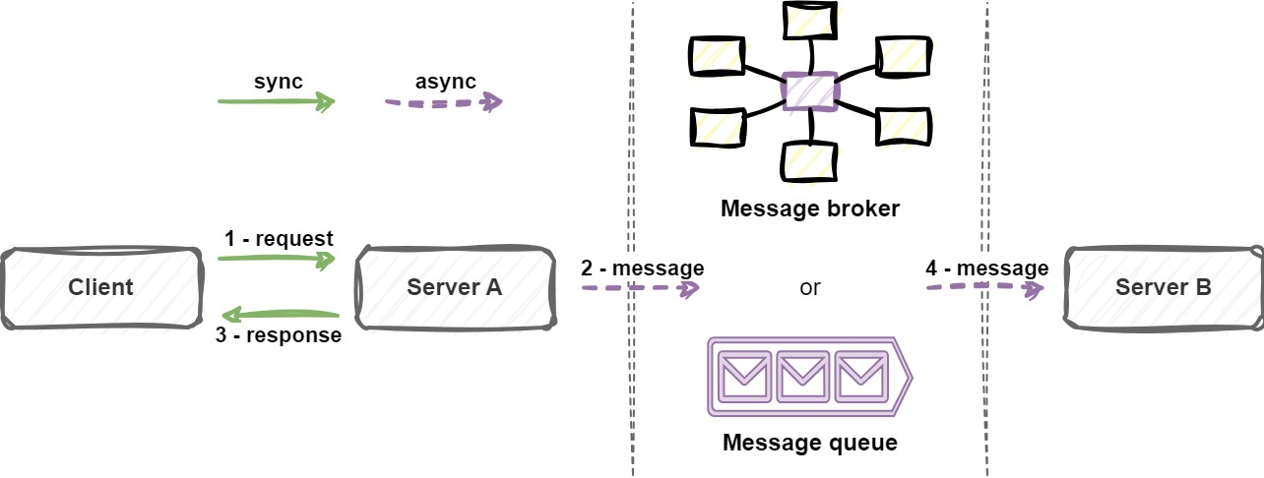
</ 3. Techniques in Saga
Asynchronous communication & Message broker
/>

Slide 27
</ 3. Techniques in Saga
Synchronous vs Asynchronous communication
Asynchronous has some characteristics that fit Saga better
 | Synchronous | Asynchronous
Technique | HTTP request | Message queue/broker
Response time | Client waits for response | Quick response
Retry | Client waits for retry | Retry in background
Throughput | Lower | Higher
Timeout | Has timeout | Almost no timeout

Slide 28
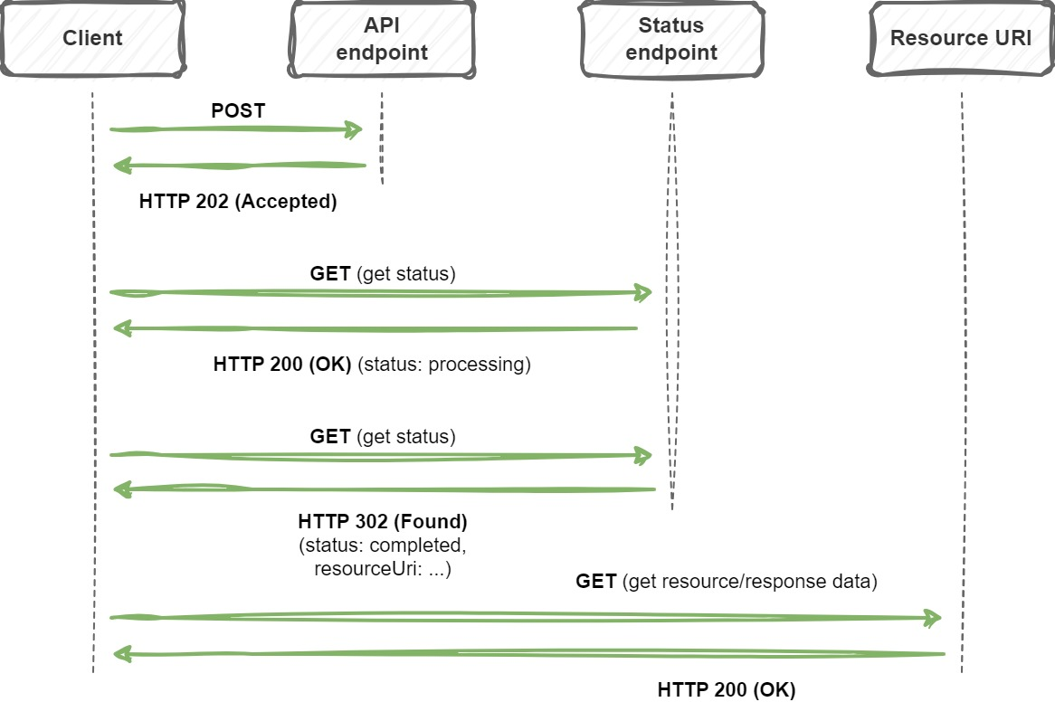
</ 3. Techniques in Saga
Asynchronous request-reply
/>

Slide 29
</ 3. Techniques in Saga
"Replay" technique
A group of logical operations can be replayed multiple times
Each operation is coordinated by the orchestrator
Operation status and result will be persisted
In the next replay, persisted result will be used if available
-> Is usually used with Event-sourcing architecture
-> More clear and readable but complicated
/>

Slide 30
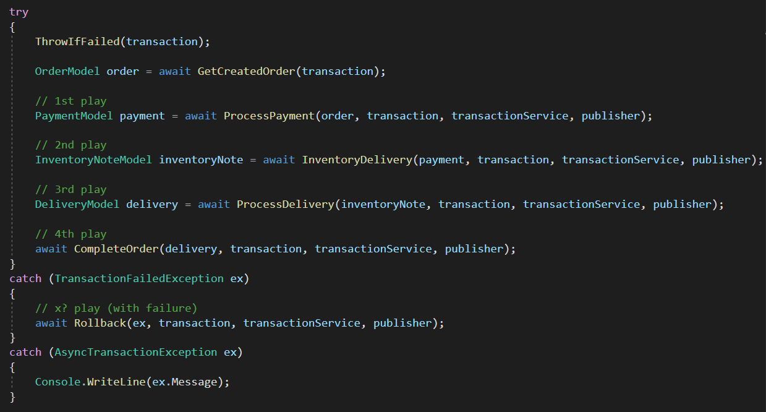
</ 3. Techniques in Saga
"Replay" technique
/>

Slide 31
</ 3. Techniques in Saga
Other techniques to ensure resiliency and target isolation, consistency issues
Heartbeat pattern
Retry
Semantic lock
Optimistic locking
Different concurrent read techniques
/>
Notes:
Semantic lock: khóa resource với một ý nghĩa nhất định, ví dụ đang thực hiện việc gì đó

Slide 32
04
Saga - Choreography
</>
} /> [

Slide 33
</ 4. Saga - Choreography
What is choreography-based saga?
A way to coordinate sagas where events are exchanged using a message broker or any mechanism without a centralized controller
Each local transaction publishes events that trigger local transactions in other participants
Participants must know each other’s events to be able to handle them
/>

Slide 34
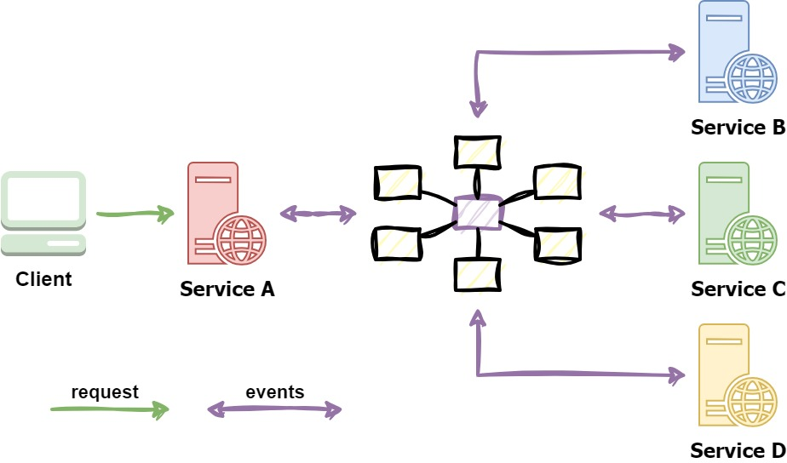
</ 4. Saga - Choreography
Flow diagram
/>

Slide 35
</ 4. Saga - Choreography
Apply to our problem (Success path)
Create order -> ?
/>

Slide 36
</ 4. Saga - Choreography
Apply to our problem (Success path)
Create order -> Order created ->
Process payment -> Payment created ->
Inventory delivery -> Delivery note created ->
Process delivery -> Delivery created ->
Complete order -> Order completed
/>

Slide 37
</ 4. Saga - Choreography
Apply to our problem (Failure paths)
Create order -> Create order failed
... Process payment -> Payment failed ->
Cancel order
... Inventory delivery -> Inventory delivery failed ->
Cancel order, Cancel payment
... Process delivery -> Delivery failed ->
Cancel order, Cancel payment, Reverse inventory delivery

Slide 38
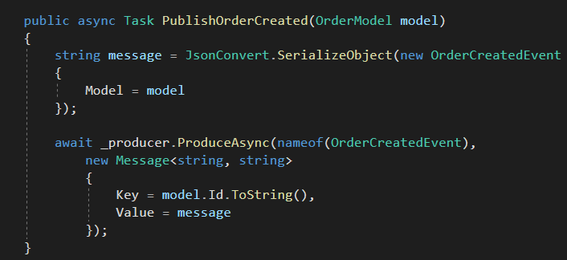
</ 4. Saga - Choreography
Apply to our demo (Publishing events)
/>
OrderService

Slide 39
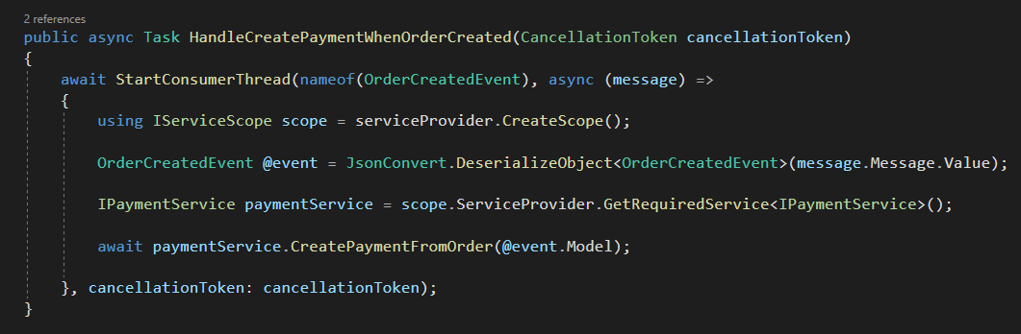
</ 4. Saga - Choreography
Apply to our demo (Handling events)
/>
PaymentService

Slide 40
</ 4. Saga - Choreography
Pros
Good for simple, few participants, no need coordination logic workflows
No need to maintain orchestrator service
No single point of failure
Responsibilities are shared and distributed
Cons
Cumbersome when adding new participants and steps
Complicated dependencies (cyclic, tight coupling) between participants
All services must be running to simulate a transaction -> difficult to do integration testing

Slide 41
05
Saga - Orchestrator
</>
} /> [

Slide 42
</ 5. Saga - Orchestrator
What is orchestrator-based saga?
Orchestrator coordinates sagas using a centralized controller
Trigger participants local transactions to perform in case of events
Handle failures by running compensating transactions/actions
Status can be managed and persisted for monitoring and management purposes
/>

Slide 43
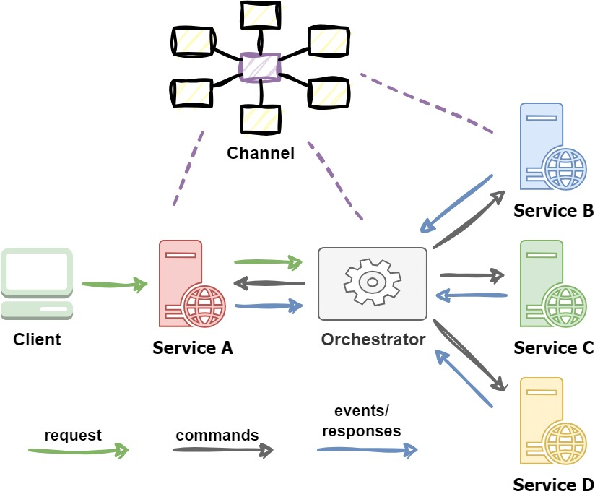
</ 5. Saga - Orchestrator
Flow diagram
/>

Slide 44
</ 5. Saga - Orchestrator
Apply to our problem (Success path)
Create order -> Order created -> ?
/>
Notes:
NOTE: we can start Orchestrator to create the order (depend on implementation)

Slide 45
</ 5. Saga - Orchestrator
Apply to our problem (Success path)
Create order -> Order created -> Orc ->
C:Process payment -> Payment created -> Orc ->
C:Inventory delivery -> Delivery note created -> Orc ->
C:Process delivery -> Delivery created -> Orc ->
C:Complete order -> Order completed -> Orc
Annotation
Orc: Orchestrator C:{action}: command that triggers action
Notes:
NOTE: we can start Orchestrator to create the order (depend on implementation)

Slide 46
</ 5. Saga - Orchestrator
Apply to our problem (Failure paths)
... Process payment -> Payment failed -> Orc ->
C:Cancel order
... Inventory delivery -> Inventory ... failed -> Orc ->
C:Cancel order, C:Cancel payment
...
Annotation
Orc: Orchestrator C:{action}: command that triggers action
Notes:
NOTE: we can start Orchestrator to create the order (depend on implementation)

Slide 47
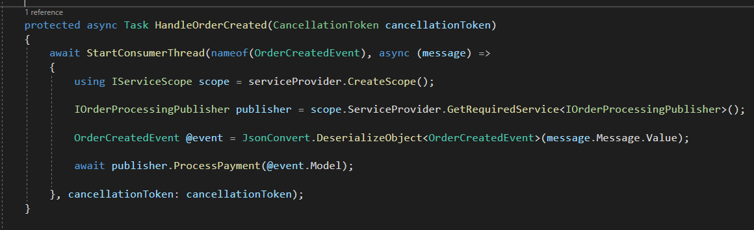
</ 5. Saga - Orchestrator
Apply to our demo (Orchestrator handles events)
/>
Orchestrator

Slide 48
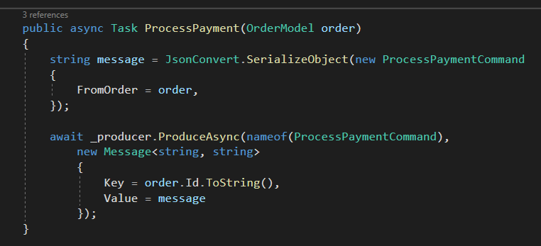
</ 5. Saga - Orchestrator
Apply to our demo (Orchestrator publishes commands)
/>
Orchestrator

Slide 49
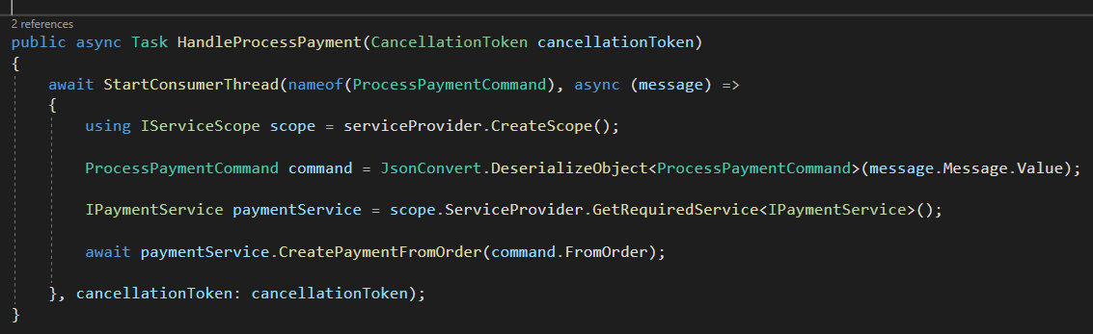
</ 5. Saga - Orchestrator
Apply to our demo (Services handle commands)
/>
PaymentService

Slide 50
</ 5. Saga - Orchestrator
Pros
Suitable for complex, many participants or new participants added over time workflows
Good when flow of tasks and activities are under control
No cyclic dependencies
Separation of concerns
Cons
Additional effort to maintain, implement coordination logic
Single point of failure
/>
Notes:
Orchestrator will know all participants but the participants themselves don’t need to know each other
Participants does not need to handle others’ events

Slide 51
06
Issues & considerations
</>
} /> [

Slide 52
</ 6. Issues & considerations
Considerations
Can be challenging in the beginning
Hard to debug
Complexity grows when there are more participants
Consistency is relative only, because changes are committed to local databases
Improper transient failures handling can cause side-effects
Difficult to manage without proper monitoring and observability implemented
Notes:
Idempotence means a logic can be repeated multiple times without changing the initial result

Slide 53
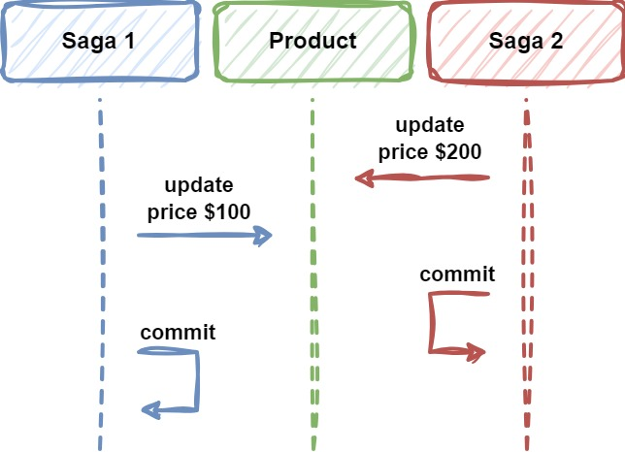
</ 6. Issues & considerations
Issues
Lost updates, a participant updates data without reading latest changes
/>

Slide 54
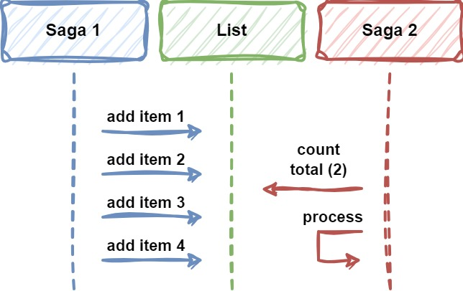
</ 6. Issues & considerations
Issues
Dirty reads, when a participant reads data that is just partially updated by another saga
/>

Slide 55
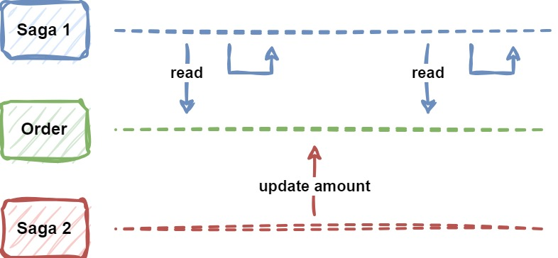
</ 6. Issues & considerations
Issues
Fuzzy/non-repeatable reads, data is not consistent across participants since data can be updated at some points throughout the entire saga workflow
/>

Slide 56
</ 6. Issues & considerations
Countermeasures against transaction isolation issues
Semantic lock
Commutative updates
Pessimistic view
Reread value and restart if data changed
Record operations in arriving order to execute sequentially
Low-risk requests use sagas, high-risk requests favor distributed transactions (2PC, 3PC distributed transaction commit/rollback protocol)
Notes:
Commutative updates: updates that can be made in any order without changing the expected result
Pessimistic view: reorders the saga, so data updates will be placed in a retryable transaction, which, at the same time, makes saga participants to read the original data and ensure data updates in the end. → calculate the whole order info throughout the saga, update at the end in a retryable transaction

Slide 57
</ 6. Issues & considerations
Solutions for resiliency
Rate limiting
Delay & retry
Idempotency
/>

Slide 58
07
Practical usage
</>
} /> [

Slide 59
</ 7. Practical usage
When to use
Ensure data consistency in a distributed system without tight coupling
Efficiently execute compensating actions if one of the operations fails in the distributed action sequence
/>

Slide 60
</ 7. Practical usage
When to use
Microservices
Cloud-based applications
Saga pattern - AWS Prescriptive Guidance (amazon.com)
Saga pattern - Azure Design Patterns | Microsoft Learn
Saga pattern - IBM Cloud Architecture Center
/>

Slide 61
</ 7. Practical usage
When to use
Banking applications: Patterns and implementations for a banking cloud transformation - Azure Architecture Center | Microsoft Learn
Media processing system: Gridwich saga orchestration - Azure Reference Architectures | Microsoft Learn
/>

Slide 62
</ 7. Practical usage
When to NOT use
Monolithic architecture
Tightly coupled operations and transactions
Cyclic dependencies
/>

Slide 63
08
Discussion
& QnA
</>
} /> [

Slide 64
</ References
Saga pattern - Azure Design Patterns | Microsoft Learn
Patterns and implementations for a banking cloud transformation - Azure Architecture Center | Microsoft Learn
Gridwich saga orchestration - Azure Reference Architectures | Microsoft Learn
Saga Pattern in Microservices | Baeldung on Computer Science
Saga Pattern for Microservices Distributed Transactions | by Mehmet Ozkaya | Design Microservices Architecture with Patterns & Principles | Medium
Distributed transaction - SAGA pattern (viblo.asia)
Implement a distributed transaction in microservices software system using Saga pattern | Careers Saigon Technology
/>

Slide 65
Thanks!
</
} /> [
Do you have any questions?
trannamtrung1st@gmail.com
(+84)76 544 1077 https://www.linkedin.com/in/trung-tran99/
/>
Please keep this slide for attribution

